Slide 1
Medical Standards for Non-Professional Pilots
Dr Robert Liddell
Aviation Medicine Consultant
AOPA Australia

Slide 2
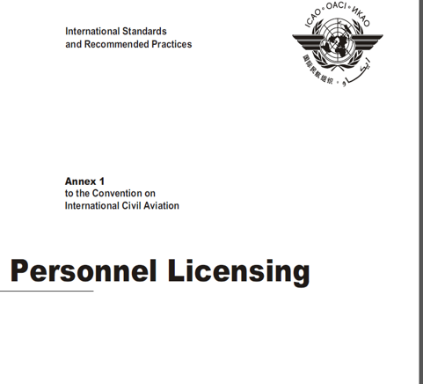
1944 Chicago Convention on Aviation Established ICAO as an Agency of United Nations

Slide 3
The only reason for the medical examination of pilots is to contribute to the safety of aviation. This is achieved by:- ensuring that the pilot has acceptable eyesight, hearing and manual dexterity to safely operate an aircraft ensuring that the pilot is not at an unacceptable risk of sudden incapacitation whilst flying the aircraft

Slide 4
Medical standards as such have rarely been a problem in certification The costs and difficulties are all around assessing the risk of inflight incapacitation The extremely low statistic for incapacitation accidents has not resulted in an appreciable easing of medical investigation and checking for recreational and private pilots

Slide 5
Australian Current Situation – Medical Standards in the Civil Aviation Safety Authority (CASA)
CASA medical standards class 1 and 2 since Chicago Convention 1944
Medical certificate issued by the regulator (CASA)
Professional (ATPL CPL)
Class 1 medical certificate required. Medical exam by CASA appointed DAME
Private Pilots (any operation that is private)
Class 2 medical certificate required. Medical exam by CASA appointed DAME
Until recently all medical examination results were submitted
to CASA for CASA Avmed to issue the certificate

Slide 6
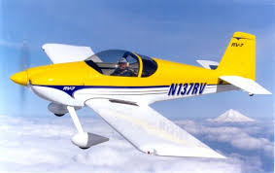
Australian Current Situation – Medical Standards in the Civil Aviation Safety Authority (CASA)
Recreational Pilot Licence Introduced in 2014
Recreational Aviation Medical Practitioners Certificate (RAMPC)
MTOW restricted to 1500 kg, not above 10,000ft, Visual Flight Rules, Max 1 pax, single engine, not turbine.
Medical exam by any GP using Austroads Assessing Fitness to Drive as unconditional private driver medical form submitted to CASA Avmed by examining doctor.
Disqualifying Conditions!
CASA added additional conditions making this unavailable to many who wanted it

Slide 7
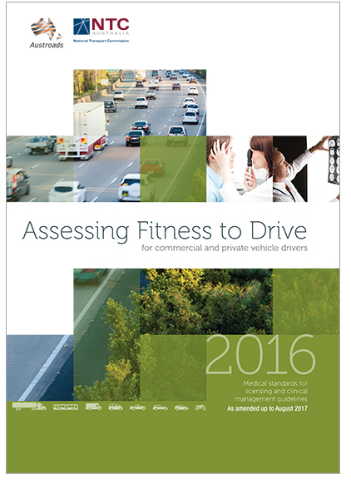

Slide 8
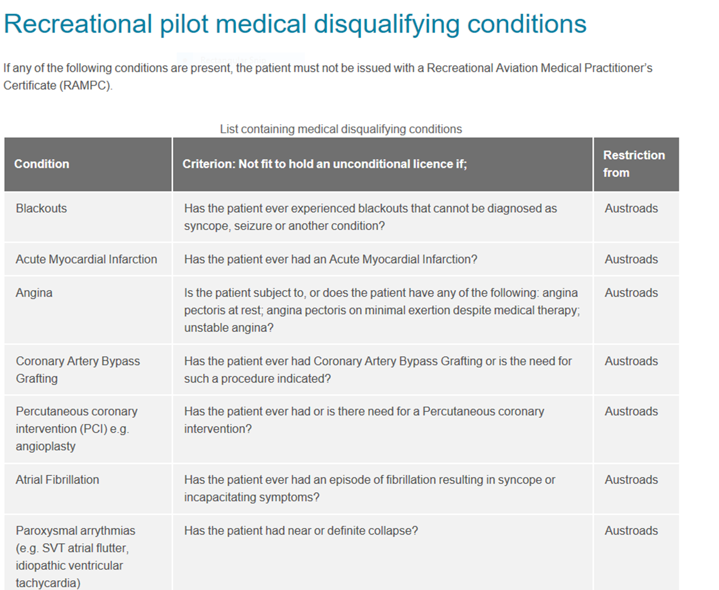

Slide 9
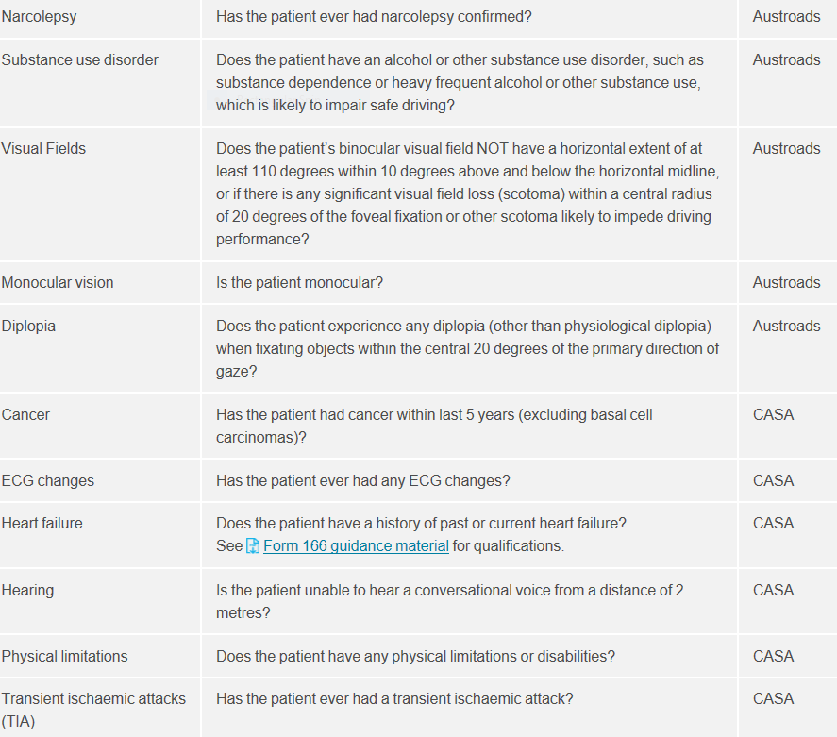

Slide 10
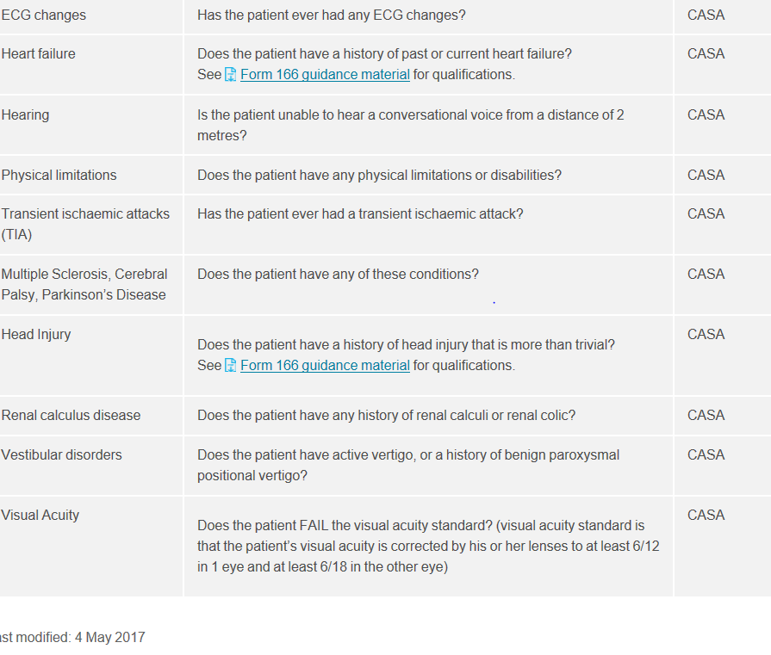

Slide 11
Non CASA Licences
Recreational Aviation Australia
Recreation Pilot Certificate (RPC)
Medical requires self declaration with medical standard to that for private motor vehicle.
Certain conditions require visit to any doctor to confirm OK for private motor licence standard.
Maximum of 2 seats (1 pax), 600kg MTOW, VFR only.
Gliding Federation of Australia
Medical requires self declaration with medical standard to that for private motor vehicle.
Certain conditions require visit to any doctor to confirm OK to meet private motor licence
standard.
There doesn’t appear to be a significantly different incidence of inflight incapacitation accidents
in this group of self certified pilots than in the group of private pilots holding a class 2 certificate
Issued by CASA

Slide 12
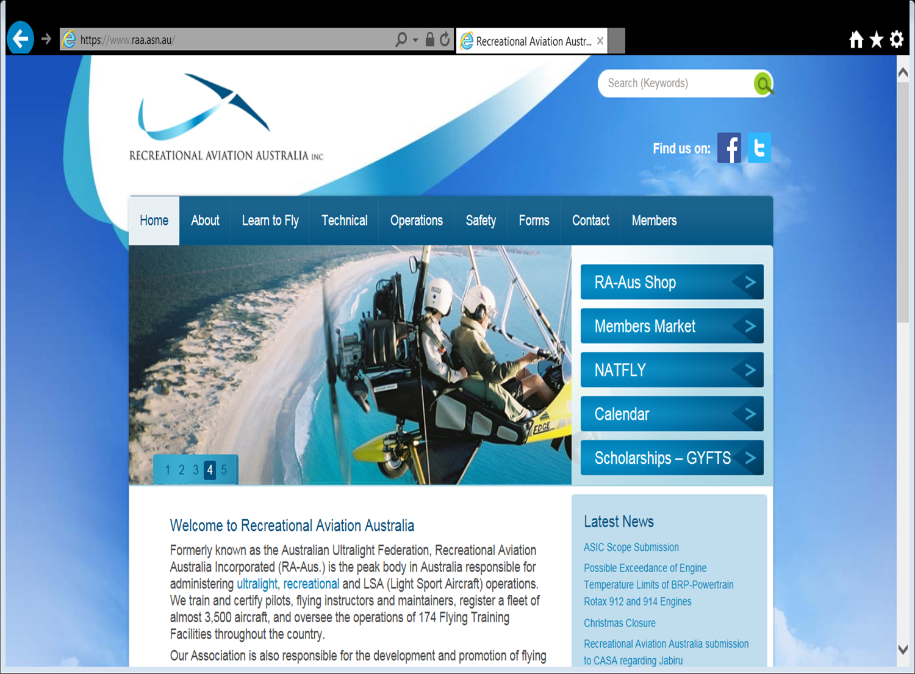
Non CASA Licence
Recreational Pilot Certificate
MTOW 600kg, 1 pax,
< 10,000 ft, VFR, 25 nm radius operation
Self declaration to standard private motor vehicle licence.
Some conditions require GP examination
CASA not involved in the medical certification process

Slide 13
This time last year it was all a bit depressing – private pilots were leaving the industry in droves as CASA Avmed made private pilots undergo medical tests to prove that they were not going to fall asleep or become incapacitated in flight. These tests cost them thousands of dollars. Net effect on safety of course was negative, the money spent on medical tests was usually then not available for private flying – we all know the biggest factor in aviation accidents is lack of currency and not inflight incapacitation!

Slide 14
Something Happened Last Year
The first significant change in recognising that pilots flying privately or for recreation do not need anything like the same level of medical certification rigor as pilots flying professionally.
This change was first seen in the USA where the efforts of AOPA and others
resulted in the first legislative changes in this area.
It is pleasing to see that the Australian regulator CASA under its new CEO
has been quick to follow suit with regulatory easing of requirements with the introduction of two initiatives
the DAME issuing the class 2 medical certificate
the basic class 2 medical certificate.

Slide 15
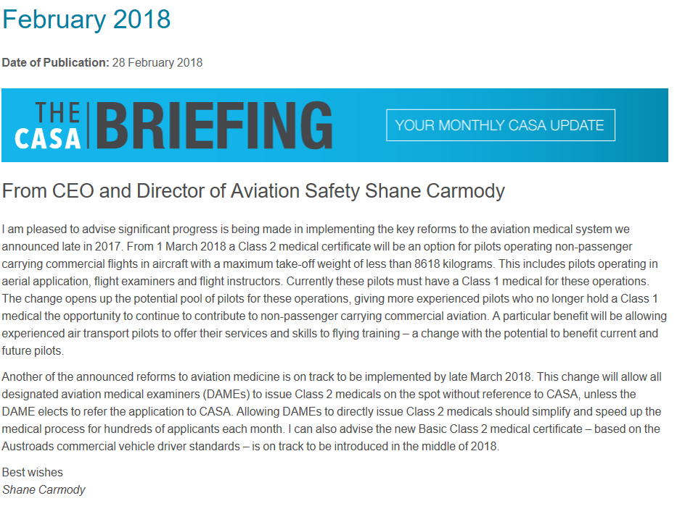

Slide 17
This is only going to make a significant difference if it relates to real change for private (class 2 pilots)
No mandatory CASA Avmed involvement or mandatory CASA tests for those with past history of any of the many conditions that currently cause grief and expense for private pilots
Conditions such as type 2 diabetes, obesity, past history of renal stone, heart problems, concussion, minor ECG changes past cancer etc can be considered by the DAME and the DAME decides if he/she want CASA involvement in the certification decision or they are prepared to make the decision themselves.
Where appropriate the DAME would still use specialist reports to improve the rigor of their decision.
Having the ability to decide on certification may expose the DAME to the potential for litigation in the event of an accident and many DAMES may choose to have CASA involved in the decision process for complex cases.

Slide 18
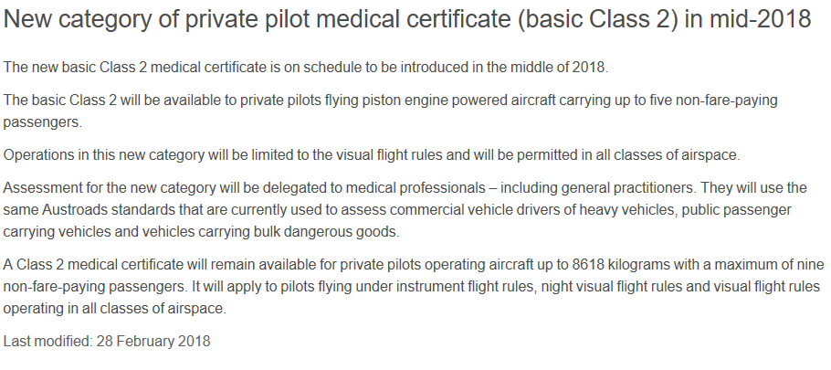

Slide 19
Austroads Commercial versus Austroads Private Licence
Significant differences exist between Austroads Private and Commercial Drivers Licence Medical Standard
Differences are related to risk and type of activity the commercial driver undertakes
Where a person has a condition that is excluded then conditional licences may be issued but that decision is made by the licencing authority in the state and the conditional licence issued
In general terms the commercial drivers licence standards are not too dissimilar to the class 1 professional pilot standard
This basic class 2 is not going to be the panacea that many pilots with medical problems are hoping for at least in part due to the fact that the standard is to be that for a commercial drivers licence not a private drivers licence

Slide 20
What we do not know at this stage
Will medical examiners issuing class two medical certificates still be required to
carry out CASA Avmed policy in certifying those pilots that have conditions which are causing so much expense and difficulty at the moment?
For example a BMI over 35 requiring sleep apnoea testing with a specialist sleep lab involvement, or type 2 diabetes requiring consults with specialist cardiologist and ophthalmologist on a yearly basis.
Will the medical examiner be free to decide if the pilot meets the class 2 standard for incapacitition risk and only require the tests if it is felt that they are necessary on an individual basis.
Will GPs conducting the new basic class 2 medical exam under Austroads commercial vehicle licence standards have to apply for a conditional medical certificate as is required for commercial vehicle drivers who have a condition that does not meet the standard. If so will Avmed or the road traffic authority be the organisation to issue a conditional medical certificate?

Slide 21
Total and complete Incapacitation
This is the problem that causes most of the certification issues
Yet we do not have a statistic for the prevalence of this event although we know it is very low
We do know that in a two crew operation (or a friend pilot in the other seat) the risk of incapacitation causing an accident in private flying is virtually non existent
We do know that with a parachute escape system ( eg Cirrus) any passenger can save the aircraft and occupants if a pilot becomes incapacitated. So can we allow a change in risk assessment for these pilots?
And the greatest cause of inflight incapacitation which we do not and cannot easily evaluate is not physical illness

Slide 22
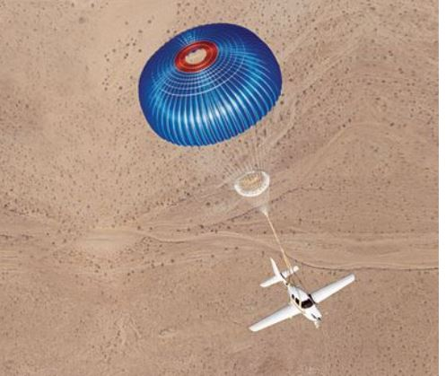

Slide 23
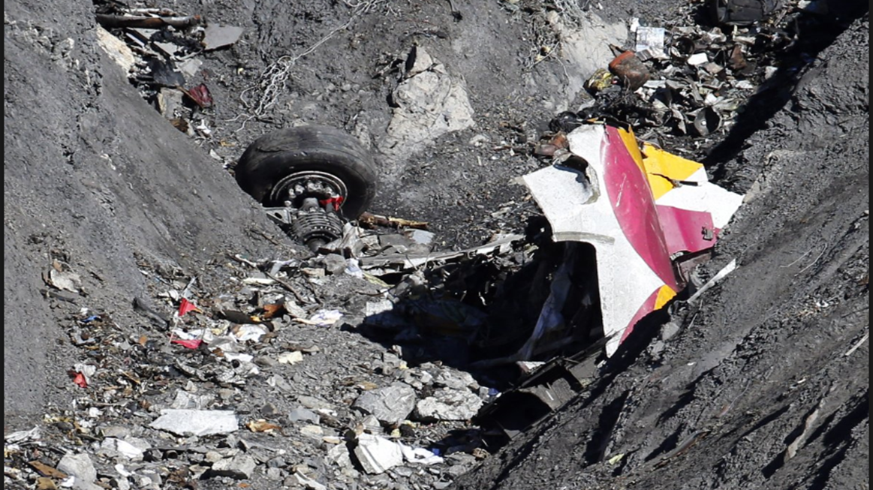
Incapacitation of the non physical kind

Slide 24
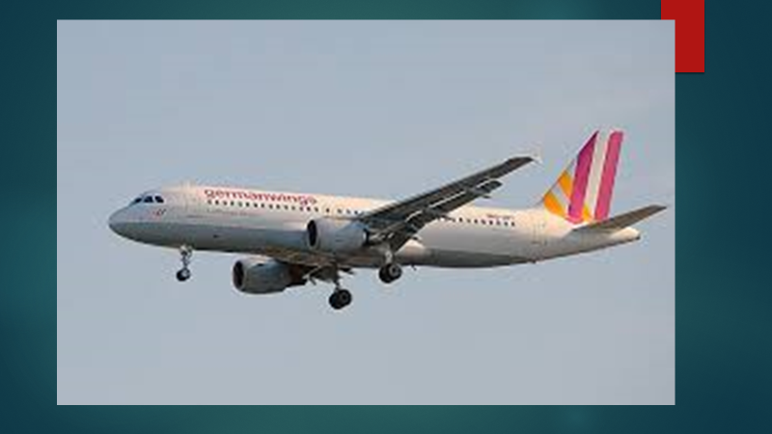
German Wings, Silk Air, Egypt Air, Malaysian, Mozambique Air
Killed 740 people since 1997

Slide 25
The bottom line
No person wishes to be party to a system that relaxes standards so much that
we see an increase in accidents caused by inflight incapacitation
By using accident and incident data from the gliding federation and recreational
aviation where self declaration medical examinations have been accepted for years we can say that we do not expect an increase in inflight incapacitation as a result of any relaxation in the medical certification process. However we must be vigilant in collecting data to be satisfied that the changes are safe
As a large percentage of private pilots fly with pilot friends, we can use the two pilot (multicrew or safety pilot) requirement a lot more and statistics tell us that only one of the two pilots needs to meet any medical standard as far as meeting the incapacitation risk is concerned
With few exceptions, pilots are responsible people, remember that every pilot self certifies when ever he or she goes flying

Slide 26
